Slide 1
Object Pool Design Pattern
Matyas Norbert

Slide 2
Definition
The object pool pattern is a software creational design pattern that uses a set of initialized objects kept ready to use – a “pool" – rather than allocating and destroying them on demand.
A client of the pool will request an object from the pool and perform operations on the returned object. When the client has finished, it returns the object to the pool rather than destroying it.

Slide 3
Advantages
Object pooling can offer a significant performance boost in situations where the cost of initializing a class instance is high and the rate of instantiation and destruction of a class is high.
The pooled object is obtained in predictable time when creation of the new objects (especially over network) may take variable time.

Slide 4
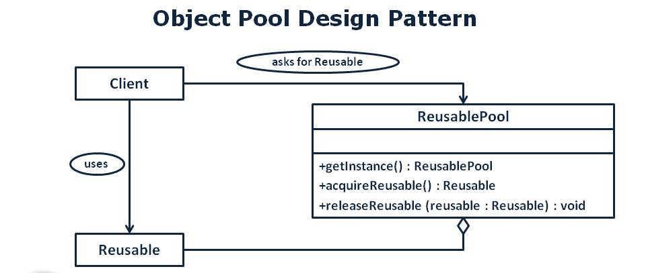

Slide 5
Example Code
Example attached as code.

Slide 6
Thank you for your attention!

